Slide 1


D200F Applications, Programs and Indentures
August 2021

Slide 2
Welcome
D200F Applications, Programs
and Indentures
Online Delivery
Daily Schedule
Breaks
Assignments
Quiz

Slide 3
Course Overview
Module 1 – Introduction to API
Module 2 – Terms and Definitions
Module 3 – Applications, Programs, and Indentures
Module 4 – API Subsystem
Introduces RMS and API systems
Configuration management
Interchangeability and Substitutability
Secondary items, ERRC codes, and NSNs
Applications, Programs, and Indentures
Illustrated Parts Breakdown (IPB)
API subsystem
Data elements, indenture formulas, and file maintenance
3

Slide 4
Module 1 - Introduction to API
Introduction to API
NOTE: D200F API is the database that houses our indenture structures and application records used in requirements computations.
SPM is used to handle requirements computations. For the foreseeable future, API will be maintained and will supply data to SPM via ODS.
4

Slide 5
Module 1 - Introduction to API
Introduction to API
Lesson 1a
D200 Requirements Management System (RMS)
5

Slide 6
Introduction to API
Lesson Preview
Explains who has responsibility for determining materiel requirements
Describes goal of AFMC when determining requirements
Explains purpose of requirements computations
Describes D200 RMS system and some subsystems, including API
6

Slide 7





Module 1 - Introduction to API
Introduction to API
AFMC determines materiel requirements for AF assets
Requirement computation = identifying materiel needs and securing necessary assets
Goal of AFMC is to provide maximum supply support at minimum taxpayer cost
Reporting of usage, assets, and special conditions affecting requirements computations
7

Slide 8

Module 1 - Introduction to API
Introduction to API
Requirements computations help meet the diverse needs of the Air Force
8

Slide 9

Module 1 - Introduction to API
Introduction to API
Funding
All AF programs depend on funds from Congress
BES (Budget Estimate Submission) is an end product of requirements computations
Correct computations = successful budget defense
9

Slide 10

Module 1 - Introduction to API
Introduction to API
SPM
Manages all information used in the computation of requirements
A software systems that processes item demand and usage
Stores data within SPM
10

Slide 11
Module 1 - Introduction to API
Introduction to API
RMS
Incorporates many subsystems:
D200C/EIP, D200E/RIID, D200F/API, D200H/IRD, D200N/CSIS
11
Notes:
D200C/EIP – Equipment Item process -
D200E/RIID – Requirements item identification Data – (provides cataloging data and stock list changes received from the Master Item identification control system (D043))
D200F/API – Applications, programs, indentures – (approved system of record for API data; It establishes a secondary item application or configuration file for each weapon system to support readiness-based sparing computations.)
D200H/IRD – Initial Requirements Determination – (subsystem is the preferred input source for program checklist)
D200N/CSIS – Central Secondary item Stratification – (display budget and repair deficits for each requirements segment by fiscal year; provides data on asset distribution against requirements and is used as a baseline for inventory analysis)

Slide 12

Module 1 - Introduction to API
Introduction to API
API
Foundation for RMS
Accuracy of RMS computations attributable to accuracy of API
Supplies parts list, application data, program data for requirements computations
12

Slide 13
Module 1 - Introduction to API
Introduction to API
Data System Designators (DSDs)
D200F is DSD for API
DSDs are assigned to all AFMC software systems
D 200 F
Type of data
(D = materiel management)
Sequentially assigned
Subsystem
13

Slide 14
Module 1 - Introduction to API
Introduction to API
End of Lesson 1a
14

Slide 15
Module 1 - Introduction to API
Introduction to API
Lesson 1b
Fundamentals of Configuration Management
15

Slide 16
Module 1 - Introduction to API
Introduction to API
Lesson Preview
Discusses fundamentals of configuration management and change
Identifies four elements of configuration management
Defines OSS&E
Explains effects of DMSMS on configuration management
16

Slide 17

Module 1 - Introduction to API
Introduction to API
Configuration Management (CM)
Configuration – the functional and/or physical characteristics of hardware and/or software as set forth in technical documentation and achieved in a product
Primary purpose of CM is to ensure documentation used to identify and describe product and the product itself are one in the same
Identifies change, manages change, ensures changes are properly implemented, reports changes, and records changes
17

Slide 18
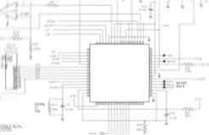
Module 1 - Introduction to API
Introduction to API
Four Elements of CM
Configuration Identification
Configuration Change Control
Configuration Audits
Configuration Status Accounting
18

Slide 19
Module 1 - Introduction to API
Introduction to API
Configuration Control Board (CCB)
Approves configuration changes
Composed of representatives from program/project functional areas
Approves or disapproves changes via ECPs
Approves conversion of ECPs to TCTOs
Issues implementation instructions
19

Slide 20
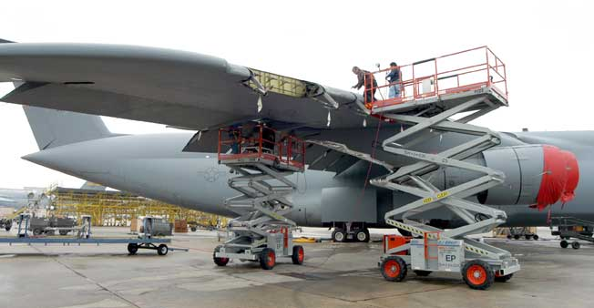
Module 1 - Introduction to API
Introduction to API
OSS&E
Operational Safety, Suitability, and Effectiveness
Do not change configuration, sources of supply, or maintenance concepts for items without approval from engineering
Engineering must approve all part substitutions.
20

Slide 21
Module 1 - Introduction to API
Introduction to API
DMSMS
The loss, or impending loss, of manufacturers of items or suppliers of items or raw materials (DoD 4140.1-R)
When a part is no longer available due to DMSMS, a substitute must be identified and approved through formal configuration control process
Form, Fit, Function, or Interface
Any configuration change is the alteration of form, fit, function, or interface and could affect the interchangeability and substitutability of an item.
21
Notes:
DMSMS – Diminishing manufacturing sources materiel shortages

Slide 22
Module 1 - Introduction to API
Introduction to API
While Configuration and change control are handled by technical orders (IPB), this data is necessary for the computation of requirements.
Until the day comes when configuration data is systematically fed to the requirements management system, we rely on Equipment Specialists to ensure that our requirements systems are kept up to date.
It’s imperative that requirements system configuration data match IPB information to avoid inaccurate requirements forecasts.
22

Slide 23
Module 1 - Introduction to API
Introduction to API
End of Lesson 1b
23

Slide 24
Module 1 - Introduction to API
Introduction to API
Lesson 1c
Interchangeability & Substitutability (I&S)
24

Slide 25
Module 1 - Introduction to API
Introduction to API
Lesson Preview
Studies Interchangeability & Substitutability (I&S)
Defines Subgroup Master (SGM) item and SGM Stock Number
Describes interchangeables and bachelor items
Explains how requirements are computed for lower subgroups
25

Slide 26

Module 1 - Introduction to API
Introduction to API
Interchangeability & Substitutability (I&S)
I&S – the conditions which permit the exchange of one item for another without affecting design or performance beyond acceptable limits
I&S Review
Superior to similar items in inventory
Similar to items in inventory
Inferior to items in inventory
Unique (one-of-a-kind)
*More info in AFMCMAN 23-103, Chapter 23
26

Slide 27
Module 1 - Introduction to API
Introduction to API
Interchangeability & Substitutability (I&S)
I&S determinations are critical to FRL, and to maximize parts supportability
Two essential concepts: Inherent characteristics and form, fit, function, and interface
Inherent Characteristics
Physical and functional qualities which describe an item
Form, fit, function, and interface
Physical and functional qualities of an end-item
27

Slide 28
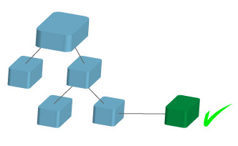
Module 1 - Introduction to API
Introduction to API
Interchangeable Items
Equivalent in performance, durability, reliability, and maintainability to another item of similar or identical purposes
Capable of being exchanged without consideration of form, fit, function, and interface, and without alteration of the item or adjoining items (except for adjustment)
Synonymous with inter changeable or two-way interchangeable.
28

Slide 29
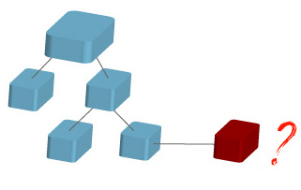
Module 1 - Introduction to API
Introduction to API
Substitutable Items
Two or more items that are similar, but one item has inherent characteristics that make it the preferred item
Capable of being exchanged only under specified conditions or for particular applications
Preferred item can replace the non-preferred item for all applications but not vice versa
Synonymous with the phrase substitutable or one-way interchangeable.
29

Slide 30
Module 1 - Introduction to API
Introduction to API
Subgroups
Subgroup structure within an I&S group depends on number of items and their interchangeability
Two or more items in same subgroup must be two-way interchangeable items
Preferred item in the subgroup is called the Subgroup Master (SGM)
One-way interchangeables are subgrouped separately and compute separate requirements
API will not permit two members of the same subgroup to be components of the same NHA
30

Slide 31
Module 1 - Introduction to API
Introduction to API
Order of Use (OOU)
Three-position code is assigned to show ascending order of preference
AAA item first to be made, ACC was the last
Two-way interchangeables share subgroups and the same second digit OOU code
31

Slide 32
Module 1 - Introduction to API
Introduction to API
Subgroup Master (SGM) Item
Each subgroup contains a SGM
There is an NSN associated with each OOU code, but requirement computations are only made for each SGM
Buys for AA or AB items are rolled to AC automatically
32

Slide 33
Module 1 - Introduction to API
Introduction to API
Two-Way vs. One-Way
Any item in a subgroup can replace another since they are two-way interchangeables
One-way interchangeables are separate subgroups
A separate indenture structure is built for each subgroup
33

Slide 34
Module 1 - Introduction to API
Introduction to API
SGM Stock Number
Identifies the most preferred item in an I&S subgroup
I&S Family and I&S Master
I&S family is all subgroups combined
Latest, most preferred item of I&S family is the I&S master
34

Slide 35
Module 1 - Introduction to API
Introduction to API
Bachelor Item
Item that has no family relationship, no interchangeability
Bachelor stock number is the master stock number for bachelor item
35

Slide 36
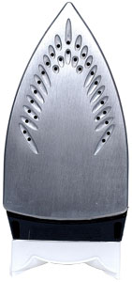
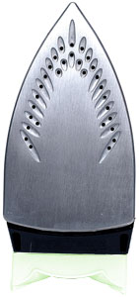

Module 1 - Introduction to API
Introduction to API
I&S Example
Westinghouse
General Electric
Sunbeam
Subgroup A | Subgroup B
AAA - AAB | ABA
Bachelor Item
SGM and I&S Master
I&S Master
36

Slide 37
Module 1 - Introduction to API
Introduction to API
End of Lesson 1c
37

Slide 38
Module 1 - Introduction to API
Introduction to API
Lesson 1d
API (D200F) and SPM
38

Slide 39
Module 1 - Introduction to API
Introduction to API
Lesson Preview
Looks at API’s relationship to the SPM system
Describes API interfaces with SPM and other subsystems
Reviews official API guidance and information sources
39

Slide 40
Module 1 - Introduction to API
Introduction to API
D200F/API
Subsystem of the D200 RMS
Approved Air Force tool for maintaining hardware indentures and relating program data to secondary items
Purpose of SPM is to compute follow-on spare requirements
40

Slide 41
Module 1 - Introduction to API
Introduction to API
API and SPM
Purpose of API is to support SPM
API maintains complete indenture structures for all end items
Application programs are input to API and are then used in SPM
API indenture portion also supports DLA, WSSP, AF DMSMS program, and AF depot maintenance activities
Purpose of API interface with SPM, is to update or correct data to the most current information.
41
Notes:
WSSP –
DMSMS – slide 21

Slide 42
Module 1 - Introduction to API
Introduction to API
API Interface with SPM
Mechanized data system that is source of information
API feeds parts and program information to ODS
SPM extracts the information from ODS
API ODS SPM
42

Slide 43
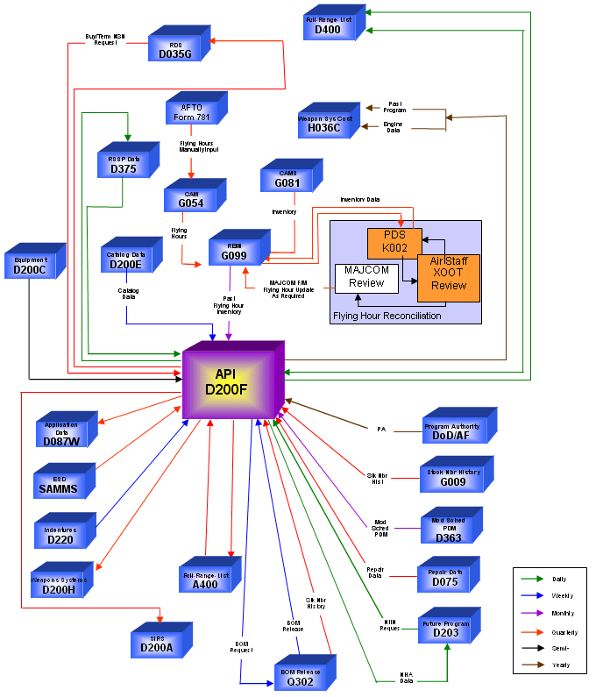
Module 1 - Introduction to API
Introduction to API
ODS
SPM
43

Slide 44
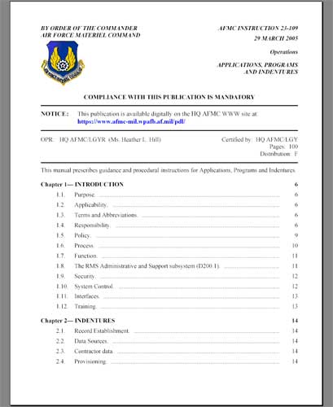
Module 1 - Introduction to API
Introduction to API
API Information Resources
Official guidance: AFMCMAN 23-109, “Applications, Programs, and Indentures”
Available at AF E-Publishing website.
Further guidance through AFMC policy letters
and ALC policies and operating instructions
44

Slide 45
Module 1 - Introduction to API
Introduction to API
End of Lesson 1d
45

Slide 46
Module 2 – Terms and Definitions
Module 2 – Terms and Definitions
Terms and Definitions
Lesson 2a
Introduction to Applications, Programs, and Indentures
46

Slide 47
Module 2 – Terms and Definitions
Terms and Definitions
Lesson Preview
Generally defines Applications, Programs, and Indentures
47

Slide 48

Module 2 – Terms and Definitions
Terms and Definitions
What are Applications, Programs, and Indentures?
Application – any assembly in an indenture chain that generates measurable program activity
Program – any activity (operating hours, PDM, etc.) that creates the need for spare parts
Indenture – the breakdown of an assembly to its components and the data that defines the relationship of the assembly to its components
48

Slide 49
Module 2 – Terms and Definitions
Terms and Definitions
Applications
“Application” refers to the NHA involved in the performance of the program
Applications include major end items, major sub-assemblies, or recoverable secondary items
Applications must be maintained
A
B
C
M
D
F
P
E
G
Z
49

Slide 50
Module 2 – Terms and Definitions
Terms and Definitions
Programs
Programs are operations and activities that create the need for repairs and repair parts
PDM programs are depot-level maintenance programs performed on aircraft, missiles, and trainers
EOH and MISTR programs are depot-level maintenance programs
Recoverable stock numbers
TMS
Support equipment stock numbers
End-item stock number and Program Element Codes (PEC)
50

Slide 51
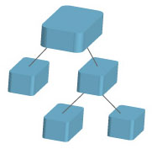
Module 2 – Terms and Definitions
Terms and Definitions
Indentures
Relationships, or “links,” that connect a component to its immediate NHA
Indenture structure relates system/end item to its smallest components
Allow users to trace NHAs or components, and to link NHA components
Relationships maintained by the ES who “owns” the NHA
Imperative to maintain indenture integrity!
51

Slide 52
Module 2 – Terms and Definitions
Terms and Definitions
End of Lesson 2a
52

Slide 53
Module 2 – Terms and Definitions
Terms and Definitions
Lesson 2b
Secondary, Recoverable, and Consumable Items
53

Slide 54
Module 2 – Terms and Definitions
Terms and Definitions
Lesson Preview
Defines secondary, recoverable, and consumable items
Defines NHA and end items
54

Slide 55

Module 2 – Terms and Definitions
Terms and Definitions
Secondary Items
Component parts that lose identity when installed in an NHA
Installed in higher assemblies or in other recoverable secondary items
Recoverable and consumable items are jointly called secondary items
55

Slide 56

Module 2 – Terms and Definitions
Terms and Definitions
Recoverable Items
Economically feasible to repair at the depot
Repair costs must not exceed 75% of FUP
Loses individual identity when installed in another piece of equipment
Sometimes referred to as MISTR items
56
Notes:
FUP – Forecasted unit price

Slide 57

Module 2 – Terms and Definitions
Terms and Definitions
Recoverable Item Example
Car Wheel Assembly
When a wheel becomes unserviceable, we could send it to a repair shop.
Parts involved to repair the wheel may include a tire, a rim, valve stem, balance weights, etc.
57

Slide 58
Module 2 – Terms and Definitions
Terms and Definitions
What is a Next Higher Assembly (NHA)?
The assembly in which a given component is directly installed
What is an end item?
A complete assembly – it has no NHA
58

Slide 59
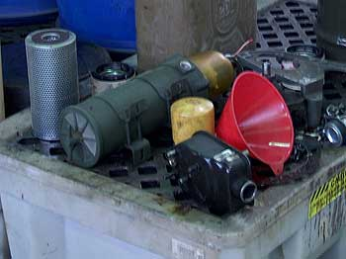
Module 2 – Terms and Definitions
Terms and Definitions
Consumable Items
Uneconomical to repair or are consumed in use
Repair costs exceed 75% of FUP
Also lose individual identity when installed in another piece of equipment
Includes items consumed in use such as oil, gasoline, paint, etc. and items that aren’t repairable.
59

Slide 60
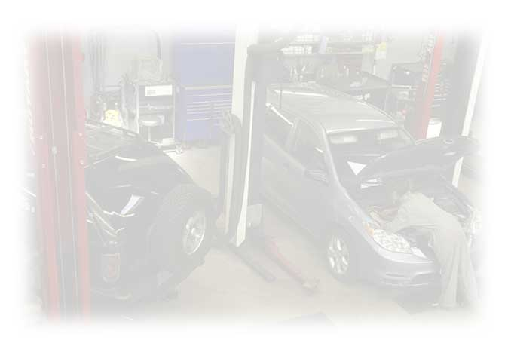
Module 2 – Terms and Definitions
Terms and Definitions
Consumable Item Example
Oil, oil filter, spark plugs, air filter, light bulbs, floor mats, mufflers, speakers, horns, etc.
60

Slide 61
Module 2 – Terms and Definitions
Terms and Definitions
End of Lesson 2b
61

Slide 62
Module 2 – Terms and Definitions
Terms and Definitions
Lesson 2c
Identifying Recoverable and Consumable Items
62

Slide 63
Module 2 – Terms and Definitions
Terms and Definitions
Lesson Preview
Examines code assigned to each federal supply item
Lists different code types and explains purpose of each
Explains repair cost ceiling and its effect
63

Slide 64
Terms and Definitions
ERRC Codes
Identify item type and management technique
Have two components:
Classify AF items into various management groupings
Found in D043A
C XD1
ERRC code ERRC designator
64

Slide 65
Module 2 – Terms and Definitions
Terms and Definitions
ERRC Designator
XD1
1st position – Expendability (E) Designator
Identifies an item as expendable or non-expendable
“X” items are expendable (recoverables and consumables)
“N” items are non-expendable (stand alone end items)
65

Slide 66
Module 2 – Terms and Definitions
Terms and Definitions
Allowance Standards
Requirements for non-expendable items are based on Allowance Standard (AS) rather than consumption
AS replaces old terminology of Table of Allowance (TA)
AS prescribes the AF equipment items and quantities to perform missions, functions, and duties
AS are available online in the AFEMS
66
Notes:
Requirements for non-expendable items are based on Allowance Standard (AS) rather than consumption
AS replaces old terminology of Table of Allowance (TA)
AS prescribes the AF equipment items and quantities to perform missions, functions, and duties
AS are available online in the AFEMS

Slide 67
Module 2 – Terms and Definitions
Terms and Definitions
ERRC Designator
XD1
2nd position – Reparability and Recoverability (RR) Designator
Identifies items that are recoverable through repair or are not normally subject to repair
Also designates level of repair or condemnation of an IOS:
B – not subject to repair or consumed in use
D – subject to repair and should be returned to depot or specialized repair activity
F – authorized to be repaired at organizational and intermediate levels
Not intended to dictate maintenance policy but to avoid over management of low price items (SMR codes dictate maintenance policy)
67

Slide 68
Module 2 – Terms and Definitions
Terms and Definitions
ERRC Designator
XD1
3rd position – Category (C) Designator
Identifies items to be given intensified or specialized attention
Items designated “1” are important to track
SCARS is technique for intensive management
Items designated “2” do not fall under intensified or specialized management
Items designated “3” are EOQ items (normally thrown away)
68

Slide 69
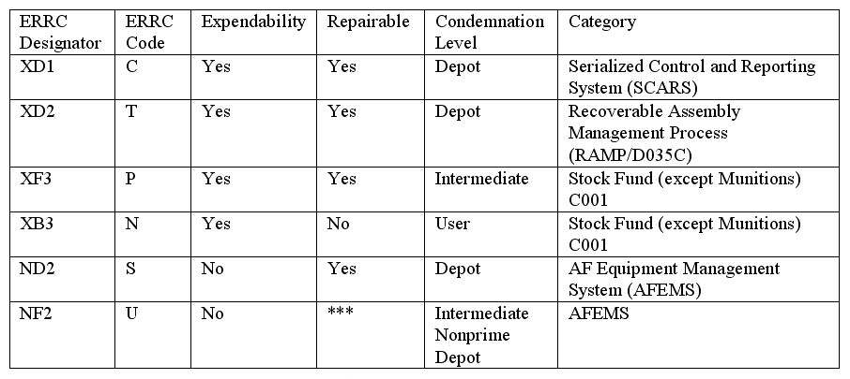
Module 2 – Terms and Definitions
Terms and Definitions
ERRC Code Table
69

Slide 70

Module 2 – Terms and Definitions
Terms and Definitions
Repair Costs and ERRC Codes
If repair costs exceed 75% FUP, the ES or Engineer reviews item for possible ERRC code change
70

Slide 71
Module 2 – Terms and Definitions
Terms and Definitions
SMR Codes
Assigned to all items that make up a system or equipment
Mandatory entry to establish an indenture in API
Portray maintenance decisions made by the ES:
Repair level responsibilities
Support methods
Disposition instructions
Reside in the IPB
Is the ES’s responsibility to update as necessary
71

Slide 72
Module 2 – Terms and Definitions
Terms and Definitions
SMR Code Example
PAOLD
P=Procurable
A=Stocked
O=Remove and Replace at the Organizational Level
L=Depot Level Repair (organic and/or contract)
D=Reparable Condemned by Depot Only
72

Slide 73
Module 2 – Terms and Definitions
Terms and Definitions
Proper SMR coding
Reduces part number requisitions
Enhances logistics support
SMR codes may require revision after systems are in operational use or when new repair/support decisions are made
See TO 00-25-195 for more SMR code info
73

Slide 74
Module 2 – Terms and Definitions
Terms and Definitions
SMR and ERRC Code Compatibility
Single position ERRC code is added to end of five position SMR code
ERRC code is a separate field in API
SMR codes should remain compatible with the ERRC code
Incompatibility demands that one or both be updated.
ES establishes ERRC and SMR codes
74

Slide 75
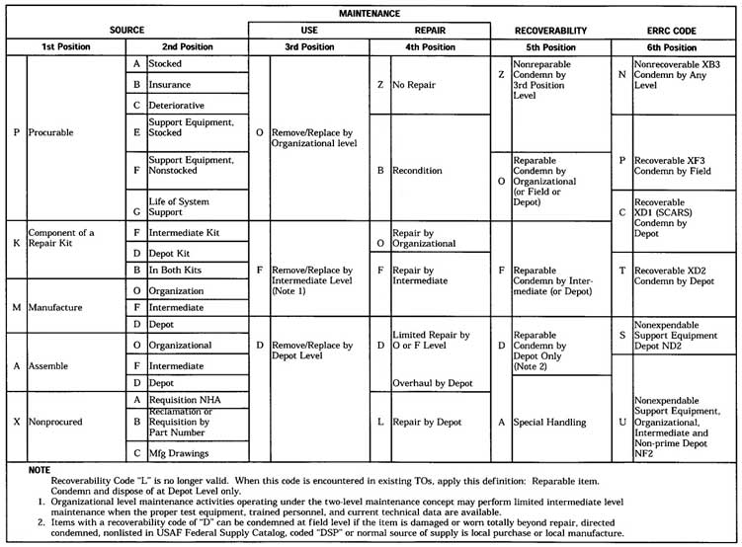
Module 2 – Terms and Definitions
Terms and Definitions

Slide 76
Module 2 – Terms and Definitions
Terms and Definitions
End of Lesson 2c
76

Slide 77
Module 2 – Terms and Definitions
Terms and Definitions
Lesson 2d
National Stock Number (NSN)
77

Slide 78
Module 2 – Terms and Definitions
Terms and Definitions
Lesson Preview
Discusses NSNs and elements that make up an NSN
Examines FSC, NIIN, NCB, and MMAC
78

Slide 79
Module 2 – Terms and Definitions
Terms and Definitions
Nouns and Part Numbers
A noun is name of the object (oil pump, valve assembly, etc.)
For file maintenance and indentures, a noun is the name of the item
A part number is a combination of numbers, letters, and symbols assigned by a designer, a manufacturer, or a vendor
Two or more completely different parts can be assigned the same part number
79

Slide 80
Module 2 – Terms and Definitions
Terms and Definitions
Commercial and Government Entity (CAGE) Codes
Five position code assigned to identify manufacturer
CAGE codes must always accompany part numbers in API
May also be referred to as Federal Supply Codes for Manufacturers (FSCM)
80

Slide 81
Module 2 – Terms and Definitions
Terms and Definitions
What is a National Stock Number?
National Stock Number (NSN) identifies each item of supply
Assigned to each supply item purchased, stocked, or distributed
Can be 13 or 15 digits
81

Slide 82
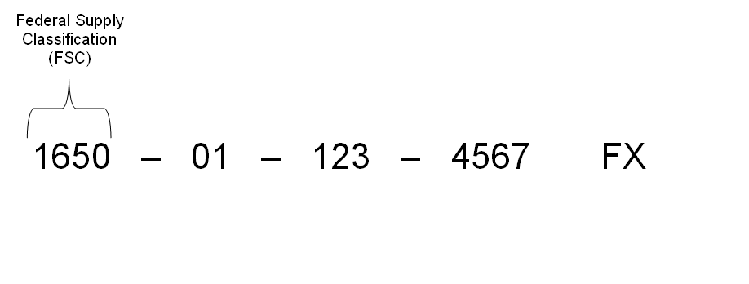
Module 2 – Terms and Definitions
Terms and Definitions
First four digits of NSN are the FSC
FSC identifies the supply classification of an item
Assigned based on the item noun IAW DLA H2 handbook
82

Slide 83
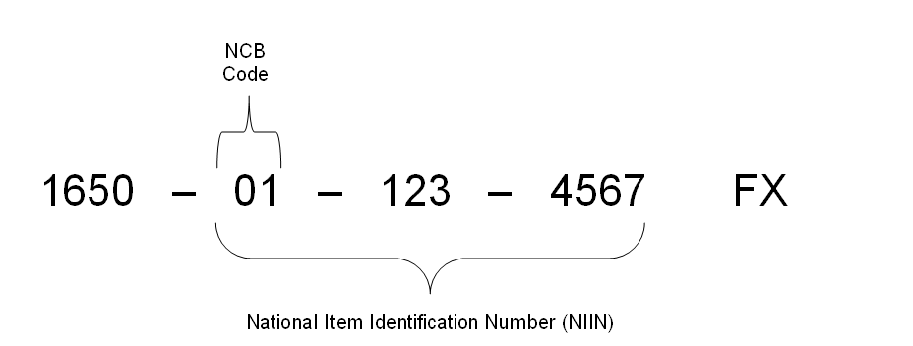
Module 2 – Terms and Definitions
Terms and Definitions
Next nine digits are the NIIN
NIIN differentiates individual supply items
Within NIIN is the NCB code (first two digits)
83

Slide 84
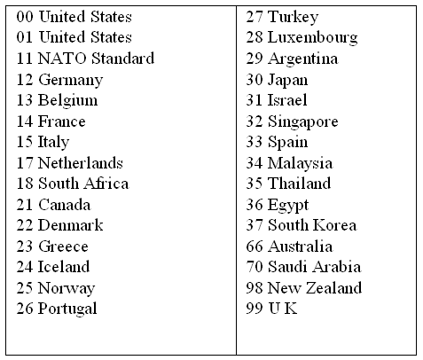
Terms and Definitions
NCB identifies country that cataloged item
US items have NCB of 00 or 01
84

Slide 85
Module 2 – Terms and Definitions
Terms and Definitions
Remaining seven digits of NIIN are unique FLIS identification numbers
NIIN stays with item while it is in supply
API indentures by part number/CAGE, not NIIN
85

Slide 86
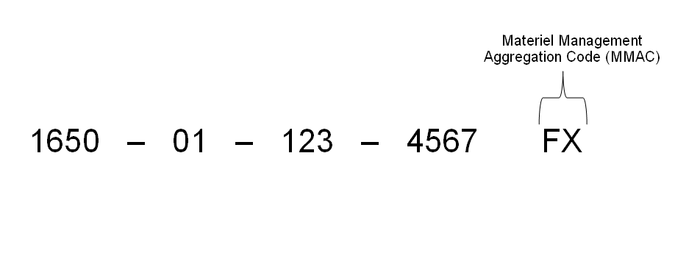
Terms and Definitions
15 digit NSNs contain the MMAC code
Two-position MMAC identifies:
Items used on only one weapon system
Special items that require special management
Items managed by someone other than FSC manager
All non-DLA items have MMAC codes
86

Slide 87
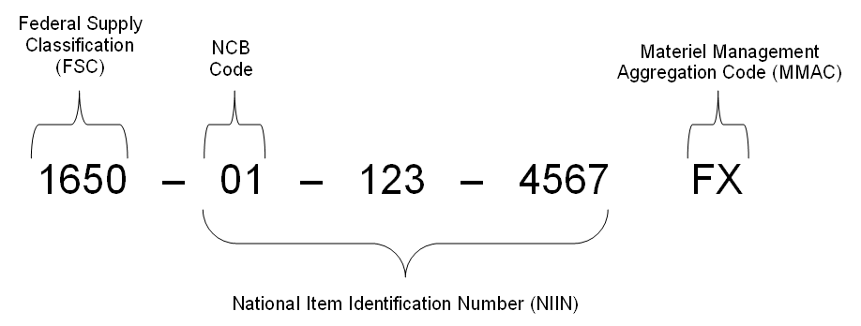
Module 2 – Terms and Definitions
Terms and Definitions
NSNs determine location of management responsibility
MMAC code always takes precedence over FSC
87

Slide 88
Module 2 – Terms and Definitions
Terms and Definitions
End of Lesson 2d
88

Slide 89
Module 3 – Applications, Programs, and Indentures
Applications, Programs and Indentures
Lesson 3a
Applications
89

Slide 90
Module 3 – Applications, Programs, and Indentures
Applications, Programs and Indentures
Lesson Preview
Looks at relationship of applications to indentures and programs
Outlines ES responsibilities for applications
90
Notes:
- API is where programs are distributed to secondary components, allows for relationships to be established between items and end items where programs are computed for SPM

Slide 91
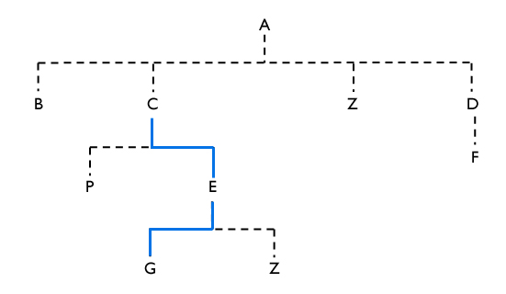
Module 3 – Applications, Programs, and Indentures
Applications, Programs and Indentures
Applications Define Relationships
Applications portion of API distributes programs to secondary components
Applications portion defines relationship between components and higher assemblies that generate programs
91
Notes:
- Defines relationship between components and the higher assemblies, it relates aerospace vehicles, equipment, engines and other end items to operational, inventory, and maintenance program data

Slide 92
Module 3 – Applications, Programs, and Indentures
Applications, Programs and Indentures
Program Selection
Assigns program data from application to components
Allows automated and manual linkage of components to applications
Each component must have at least one application to compute requirements
Program data are directly assigned to each application
Data elements unique to each application determine how much program to assign to each component
92
Notes:
- API program selection allows linking of components to their application, and you have to have at least one application in order to compute requirements

Slide 93

Module 3 – Applications, Programs, and Indentures
Applications, Programs and Indentures
ES Application Responsibilities
Ensures that indentures and application data are complete and accurate
File maintains all needed applications into API
File maintains each item’s Program Selection record
93
Notes:
-As the ES, you ensure complete and accurate indenturing
- AFMCMAN 23-101

Slide 94
Module 3 – Applications, Programs, and Indentures
Applications, Programs and Indentures
End of Lesson 3a
94

Slide 95
Module 3 – Applications, Programs, and Indentures
Applications, Programs and Indentures
Lesson 3b
Programs
95

Slide 96
Module 3 – Applications, Programs, and Indentures
Applications, Programs and Indentures
Programs
Lesson Preview
Studies nine program types employed by applications
Identifies programs used most frequently
Explains purpose of application programs
Explains how past and future programs are used
Defines item installed program and explains how they’re computed
Lists sources for each program type
96

Slide 97

Module 3 – Applications, Programs, and Indentures
Applications, Programs and Indentures
Programs
Types of Programs Employed by Applications
Specific programs are activities which create the need for repair parts, maintenance, or overhauls
Eight different program types used in requirements computations
97

Slide 98
Module 3 – Applications, Programs, and Indentures
Applications, Programs and Indentures
Programs
Program Types
Type 1: Operating Hours
Hourly programs include flying hours and equipment operating hours
Hourly programs expressed in 100 hour increments (345 hours on factors printout means item operated for 34,500 hours)
Type 3: Inventory or Equipment Months
Average number of end items in inventory for a given month multiplied by three
30 equipment months for Q1 = 10 units per month
98

Slide 99
Module 3 – Applications, Programs, and Indentures
Applications, Programs and Indentures
Programs
Program Types (cont.)
Type 4: Program Depot Maintenance (PDM)
Number of scheduled depot level overhauls of an application
Excludes XD1, XD2, and ND2
Type 5: Sorties
Represents sorties, or the number of takeoffs and landings for the aircraft
More efficient computations for certain types of equipment (tires, landing gear, etc.)
Type 6: Engine Overhaul (EOH)
Number of scheduled depot level overhauls of an engine
99

Slide 100
Module 3 – Applications, Programs, and Indentures
Applications, Programs and Indentures
Programs
Program Types (cont.)
Type 7: Drone Recoveries
Equal to launches minus expenditures
Type 8: Ammunition Expenditures
Number of rounds fired, or expected to be fired, through weapon
Displayed in thousands of units for future programs; actual numbers for past quarters
Type 9: NHA MISTR
Repairing NHAs creates a repair program for its components
NHA MISTR are depot level maintenance programs pertaining to recoverable or support equipment stock number applications
Equal to actual depot overhaul repair or reparable assets that have been made serviceable during MISTR repair process
100

Slide 101
Module 3 – Applications, Programs, and Indentures
Applications, Programs and Indentures
Programs
Two Categories of Programs
Organizational and Intermediate Maintenance (OIM) programs
Activities at operational user’s level
Types: operating hours, equipment months, sorties, drone recoveries, ammunition expenditures
Depot Level Maintenance (DLM) programs
Activities during end item overhaul or higher assembly depot level repair
Types: PDM, EOH, NHA MISTR
101

Slide 102
Module 3 – Applications, Programs, and Indentures
Applications, Programs and Indentures
Programs
Program Data Example
OIM Type
Hours
Equipment Months
Sorties
Drone Recoveries
Ammo Expenditures
DLM Type
PDM
EOH
NHA MISTR
102

Slide 103
Module 3 – Applications, Programs, and Indentures
Applications, Programs and Indentures
Programs
What is an item program?
The program performed by the item
Term used throughout requirements computations
Must be forecastable
ES determines type of item program to be developed and ensures input to API
How are past item programs used?
Used to compute the OIM, PDM, EOH, and NHA MISTR rates and percents (factors)
103

Slide 104
Module 3 – Applications, Programs, and Indentures
Applications, Programs and Indentures
Programs
How are future item programs used?
Used to compute projected requirements
ES is responsible to ensure correct applications are input to API
What is an item installed program?
Program performed or to be performed by item while installed
104

Slide 105
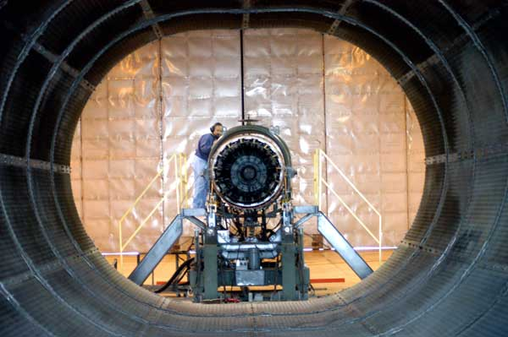
Module 3 – Applications, Programs, and Indentures
Applications, Programs and Indentures
Programs
Sources of Application Programs
HQ AFMC, System Program Managers, Engine Managers, Inventory Managers
105

Slide 106
Module 3 – Applications, Programs, and Indentures
Applications, Programs and Indentures
Programs
End of Lesson 3b
106

Slide 107
Module 3 – Applications, Programs, and Indentures
Applications, Programs and Indentures
Lesson 3c
Indentures
107

Slide 108
Module 3 – Applications, Programs, and Indentures
Applications, Programs and Indentures
Indentures
Lesson Preview
Defines indenture chains and indenture levels
Explains how indenture structure relates to the IPB
Describes ES responsibilities for maintaining indenture structures
108

Slide 109
Module 3 – Applications, Programs, and Indentures
Applications, Programs and Indentures
Indentures
Indenture Chain
One or more indenture relationships showing an end item’s relationship to the smallest component
Allows users to trace NHA or lower assembly components and link NHA components together
Building a full indenture chain may require several ES’s at different ALCs
No limit to number of indentures that can form an indenture chain
109

Slide 110
Module 3 – Applications, Programs, and Indentures
Applications, Programs and Indentures
Indentures
Indenture Level
Level of the component or assembly (highest level is system, lowest is component)
Used within an indenture chain to denote distance of items
110

Slide 111
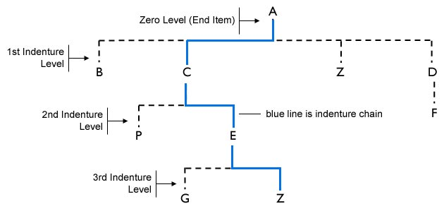
Module 3 – Applications, Programs, and Indentures
Applications, Programs and Indentures
Indentures
Indenture Example
111

Slide 112
Module 3 – Applications, Programs, and Indentures
Applications, Programs and Indentures
Indentures
Indentures and IPBs
Indentures should reflect the IPBs in the -4 series of TOs
IPB provides instructions for identifying and requisitioning parts and illustrates assembly and disassembly
Indenture structure is like IPB structure
112

Slide 113
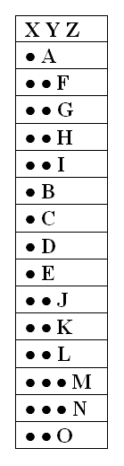
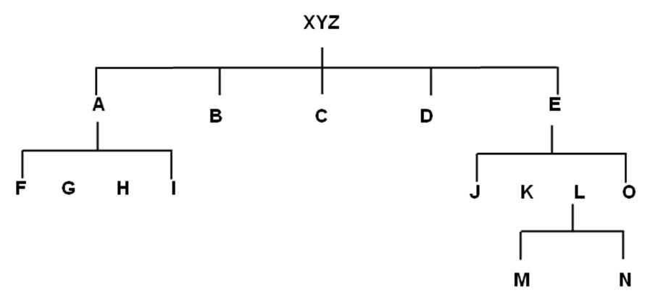
Module 3 – Applications, Programs, and Indentures
Applications, Programs and Indentures
Indentures
Indenture and IBP structure example
Indenture IPB (-4 TO)
113

Slide 114
Module 3 – Applications, Programs, and Indentures
Applications, Programs and Indentures
Indentures
Indenture Relationships Maintained by the ES
Indenture integrity must be maintained
Indenture records through automated API interface and manual input
ESs, ALC OPRs, and HQ AFMC analysts may update indenture records
Only responsible ES may add, change, or delete data for specific component or subassembly
ESs must ensure changes to indenture structures are reflected in API
ESs must correct inaccurate indenture structures
114

Slide 115
Module 3 – Applications, Programs, and Indentures
Applications, Programs and Indentures
Indentures
End of Lesson 3c
115

Slide 116
Module 3 – Applications, Programs, and Indentures
Applications, Programs and Indentures
Lesson 3d
The Illustrated Parts Breakdown (IPB)
116

Slide 117
Module 3 – Applications, Programs, and Indentures
Applications, Programs and Indentures
Lesson Preview
Looks at IPB as authoritative source for indenture information
117

Slide 118
Module 3 – Applications, Programs, and Indentures
Applications, Programs and Indentures
Illustrated Parts Breakdown (IPB)
Part - component relationships
Identification and requisitioning of parts
Identification of item management methods, shipping requirements, etc.
Defines types of stock
Does not provide maintenance or assembly instructions
118

Slide 119
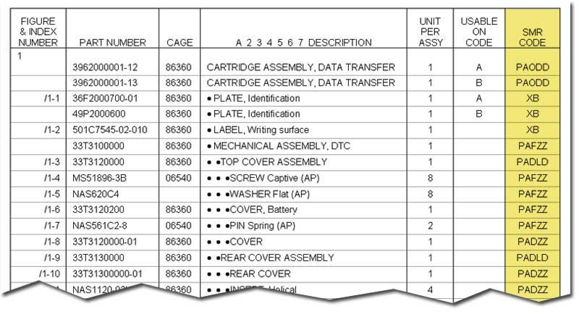
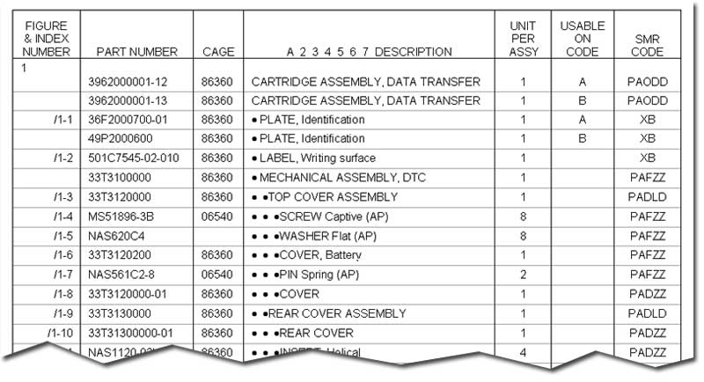
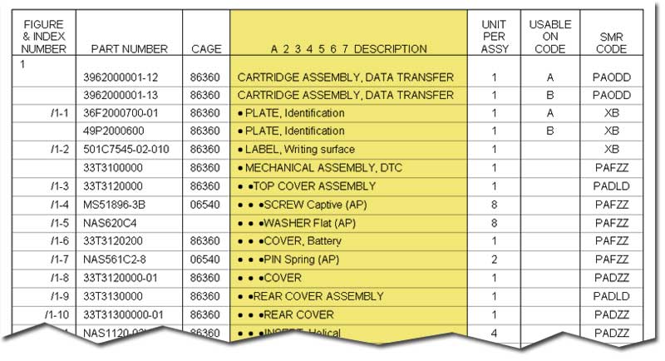
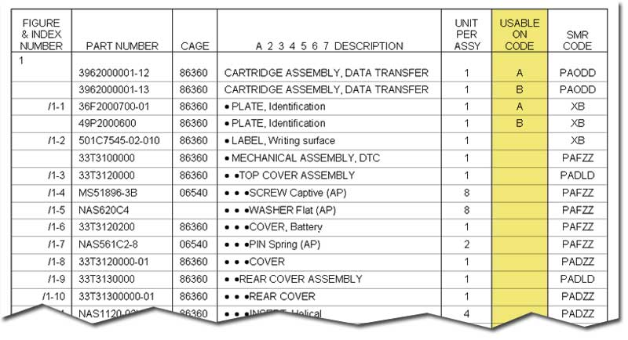
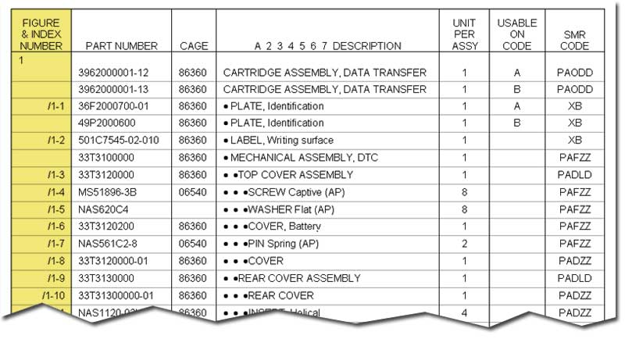
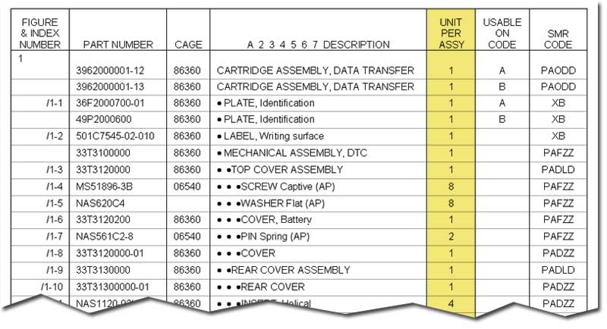
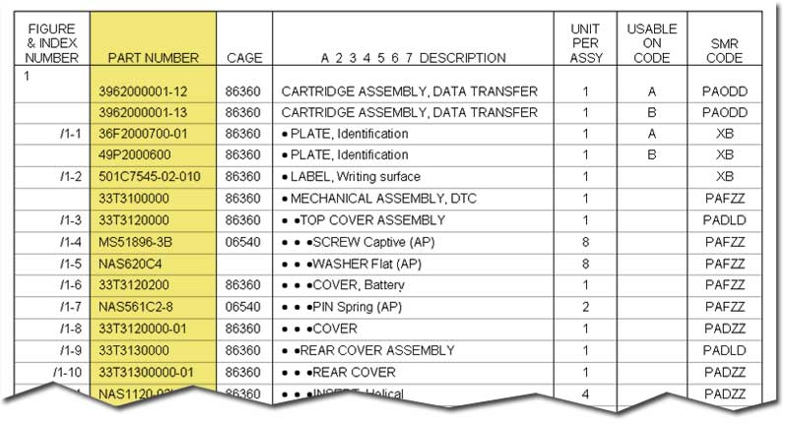
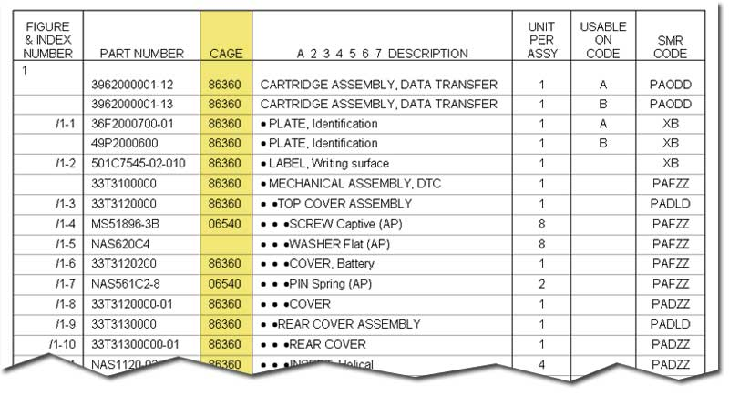
Module 3 – Applications, Programs, and Indentures
Applications, Programs and Indentures
119

Slide 120
Module 3 – Applications, Programs, and Indentures
Applications, Programs and Indentures
End of Lesson 3d
120

Slide 121
Module 4 – API Subsystem
API Subsystem
Lesson 4a
Application Data
121

Slide 122
Module 4 – API Subsystem
API Subsystem
Lesson Preview
Defines various application data elements:
Standard Program Designator (SPD)
Program Select Code (PSC)
Program Development Code (PDC)
Program Begin Date (PBD)
Quantity Per Application (QPAPPL)
Application Percent (APPL%)
122

Slide 123

Module 4 – API Subsystem
API Subsystem
Application Data is Vital
Application data is foundation of
Requirements planning
Application data is vital to conversion
of application programs to item
programs
Application data must be complete and accurate
Each application must be established in API
ES must file maintain application data
Accurate info can be obtained from historical records or TOs
123

Slide 124
Module 4 – API Subsystem
API Subsystem
Component Item Review List
A source of application data
Information can be used to identify end item applications
Contains information from all ALCs
Can be verified with IPB, TO, or drawings
Requested by ES on an as needed basis
124

Slide 125
Module 4 – API Subsystem
API Subsystem
API Application Format
Must be typed onscreen exactly, including leading spaces
Unique combination of 25 letters, spaces, numbers assigned to NHA
 | 1 | 2 | 3 | 4 | 5 | 6 | 7 | 8 | 9 | 10 | 11 | 12 | 13 | 14 | 15 | 16 | 17 | 18 | 19 | 20 | …
MDS |  | K | C | 1 | 3 | 5 | R
TMS |  | T | F | 0 | 0 | 3 | 0 | 1 | 0 | 3
Missile | A | G | M | 0 | 8 | 6 | B
Drone |  | Q | F | 1 | 0 | 6 | B
Trainer | 1 | A | D | 0 | 0 | 0 | A
NSN | 0 | 1 | 5 | 6 | 4 | 8 | 5 | 7 | 3
PEC | 5 | 6 | 0 | 1 | 3
MOD |  |  | B | 0 | 5 | 2 | H |  |  |  |  |  | R | F | 4 | 5 | 3 | 2 | 4 | A
125

Slide 126
Module 4 – API Subsystem
API Subsystem
Application Data Elements
Standard Program Designator (SPD)
Program Select Code (PSC)
Program Development Code (PDC)
Program Begin Date (PBD)
Quantity Per Application (QPAPPL)
Application Percent (APPL%)
126

Slide 127
Module 4 – API Subsystem
API Subsystem
Standard Program Designator (SPD)
Application = SPD
SPD is end item or assembly that generates programs
SPD becomes application when one or more components have been selected to receive program data from that SPD
Each application must be established in API as an SPD
SPD can be up to 25 characters long
127

Slide 128
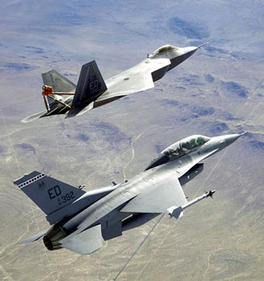
Module 4 – API Subsystem
API Subsystem
Types of SPDs
A = Aircraft
C = Communication/Electronic/Meteorological (CEM)
D = Engine Module
E = Engine
G = Gun
L = Communication/Electronic Network
M = Missile
P = Program Element Code
Q = Support Equipment
R = Drone
T = Trainer
V = Support Equipment (Vehicle)
X = Auxiliary Power Unit (APU)
Z = Modification Designation
128

Slide 129
Module 4 – API Subsystem
API Subsystem
Program Select Code (PSC)
Selects type of program used in requirements computations
Two position code
ES can file maintain one OIM, one DLM program type per application
1st Position (OIM) | 2nd Position (DLM)
0 – No OIM program | 0 – No DLM program
1 – Operating hours | 4 – Programmed Depot Maintenance (PDM)
3 – Equipment months | 6 – Engine Overhaul (EOH)
5 – Sorties | 9 – NHA MISTR
7 – Drone recoveries
8 – Ammunition expenditures
129

Slide 130
Module 4 – API Subsystem
API Subsystem
Program Development Code (PDC)
Manually file maintained in application data record
Allows ES to determine which program is to be used in requirements computation: past program, future program, or both
Field usually blank (system develops both past and future programs)
130

Slide 131
Module 4 – API Subsystem
API Subsystem
Program Begin Date (PBD)
Describes when an item became operational on an application
Starting point for computing an item program
Field reflects last month of quarter when component was first installed on SPD
Quarter expressed in YYYY/MM format: June 1985 = 1985/06
Only 03, 06, 09, and 12 acceptable in quarter column
PBD required by API
Cannot be file maintained as 0000 or left blank
131

Slide 132
Module 4 – API Subsystem
API Subsystem
Quantity Per Application (QPAPPL)
Maximum quantity of item installed on the application
Should never be zero
Should not be confused with Quantity Per Assembly (QPA)
132

Slide 133
API Subsystem
Application Percent (APPL%)
Percentage of higher assemblies that have a component installed
API assigns 100% as default percent for each component-application
ES can change APPL% in API Program Selection function
Most common reason to change APPL% is to reflect mod schedule
Displayed as “Override Application Percent” when changed by ES
ES responsibility to know and maintain correct APPL%
133

Slide 134
API Subsystem
End of Lesson 4a
134

Slide 135
Module 4 – API Subsystem
API Subsystem
Lesson 4b
Establishing Indenture Records
135

Slide 136
Module 4 – API Subsystem
API Subsystem
Lesson Preview
Covers indenture record establishment
136

Slide 137

Module 4 – API Subsystem
API Subsystem
Record Establishment
ESs, ALC OPRs, and HQ AFMC analysts may update indenture records
Only responsible ES may add, change, or delete data for particular component or assembly
137

Slide 138

Module 4 – API Subsystem
API Subsystem
Automated Data Sources
Contractor Data
Provisioning
138

Slide 139

Module 4 – API Subsystem
API Subsystem
Contractor Data
AF acquires indenture records from manufacturers
Records are complete indenture files in electronic form
Formats and procedures in AFMCMAN 23-109, Chapter 7
139

Slide 140
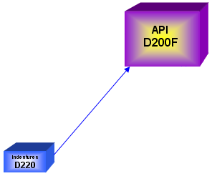
Module 4 – API Subsystem
API Subsystem
Provisioning
Creates indenture records through interface with D220
D220 produces indenture file that reflects PPL
You should manually add any missing indentures
You must ensure accuracy of indentures before passing
them to API
140
Notes:
PPL –provisioning parts list

Slide 141
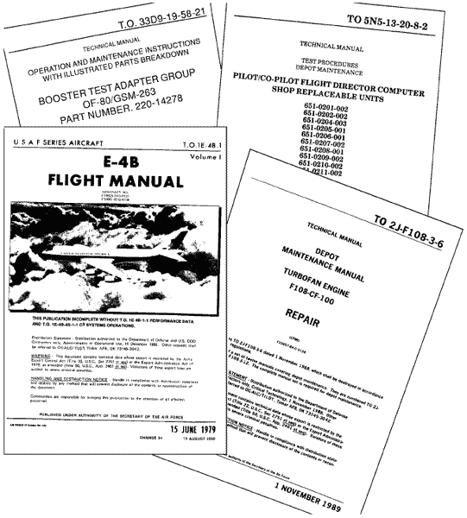
Module 4 – API Subsystem
API Subsystem
Manual Data Sources
Online system
Primary sources
IPB in –4 TOs
Technical manuals
Provisioning documents
141

Slide 142
Module 4 – API Subsystem
API Subsystem
Other Sources
API automatically establishes indenture records when components without a record are replaced
API places “V” in SID code area, and “REVIEW” in BSN field of indenture screen
ES reviews the indenture and either accepts the change by adding a review date, or adds the correct indenture information
New Components for Existing NHA product advises you of condition
Review product and use it to build or change records
142

Slide 143
API Subsystem
Indenture Data Sustainment
You are responsible for maintaining indenture data within API for the life of the system or end item
Incorporate any changes within API
File maintain review dates!
NHA review dates can’t be over 18 months old.
Change processes:
Notifications
Design changes
Cataloging actions
Component replacement usage
TO actions
SMR codes
Repair programs
143

Slide 144
Module 4 – API Subsystem
API Subsystem
End of Lesson 4b
144

Slide 145
Module 4 – API Subsystem
API Subsystem
Lesson 4c
Fundamental Indenture Terms and Formulas
145

Slide 146
Module 4 – API Subsystem
API Subsystem
Lesson Preview
Covers fundamental indenture terms and formulas
146

Slide 147
Module 4 – API Subsystem
API Subsystem
Production History
Number of end items that were repaired
Includes:
PDM
EOH
Depot repair of NHA recoverable end item
147

Slide 148
Module 4 – API Subsystem
API Subsystem
Consumption History
Materials consumed to accomplish the repair
Cannot be consumption history without production history
Includes:
Consumption quantity
Consumption date
Source of repair
Date and source of repair must match NHA production
Production and consumption history indicate future needs
Keep separate consumption records for components used in the repair of multiple NHAs
148

Slide 149
Module 4 – API Subsystem
API Subsystem
Indenture Replacement Percent (REPL%)
Identifies how often a component is removed and replaced
Used within single level of indenture
Consumption History
X 100 = REPL%
Production History X QPA
149

Slide 150
Module 4 – API Subsystem
API Subsystem
REPL% Examples
Example 1) Outboard Wheel Half on C-5 is being replaced during the MISTR repair of the Wheel 37% replacement rate minus 10% for fixing fatigue cracks equals a 27% replacement rate is file maintained as estimate by the ES
Example 2) Replacement percent for valve packing
Maximum REPL% in API is 125 percent (default is 0 %)
45
X 100 = REPL% of 90
50 X 1
150

Slide 151
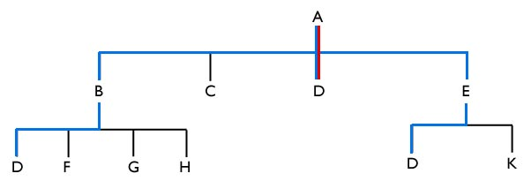
Module 4 – API Subsystem
API Subsystem
Derived Replacement Percent
Considers all indenture levels between component and application
Consumption History
X 100 = Derived REPL%
Production History X QPAPPL
151

Slide 152
Module 4 – API Subsystem
API Subsystem
Override Replacement Percent (OVRD REPL%)
ES estimate of replacement percent
Can only be assigned with N, P, C, or T ERRC codes
Only used for Materiel Requirements List (MRL) or Purchase Request Support List (PRSL)
152

Slide 153
Module 4 – API Subsystem
API Subsystem
Replacement Percent Source Reference Code (SRC)
Displays the source of the replacement percent
Blank with two or more indenture levels
Possible SRC codes:
A = actual
C = computed or computer assigned
E = entered
S = standard (default value)
D = contractor quotes
P = peacetime values in OWRM computation
W = wartime values in OWRM computation
F = not entered during initial indenture establishment
153

Slide 154
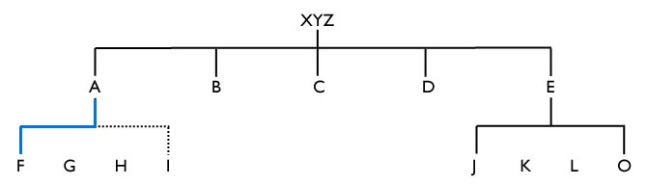
Module 4 – API Subsystem
API Subsystem
Quantity Per Assembly (QPA)
Number of components installed on the immediate NHA
File maintained by ES in API
Do not confuse with QPAPPL
154

Slide 155
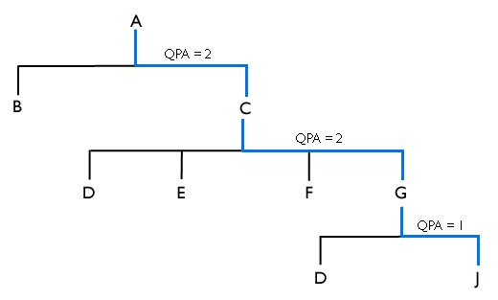
Module 4 – API Subsystem
API Subsystem
Derived Quantity Per Application (QPAPPL)
Total number of components per NHA/SPD
Derived QPAPPL is mechanically computed by API
2 X 2 X 1 = QPAPPL of 4
155
Notes:
SPD – System programming designator

Slide 156
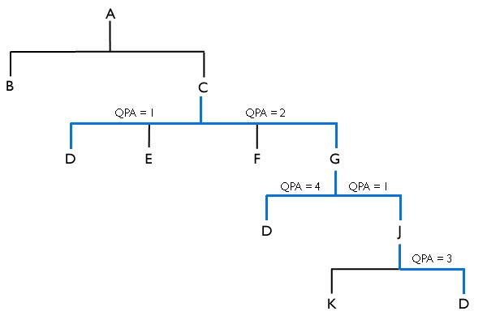
Module 4 – API Subsystem
API Subsystem
QPAPPL for Multiple Chains
C-D = 1
C-G-D = 8
C-G-J-D = 6
1 + 6 + 8 = QPAPPL of 15
156

Slide 157
API Subsystem
Override Quantity Per Application (OVRD QPAPPL)
ES can change QPAPPL in Program Selection function
Changed values displayed as “OVRD QPAPPL”
ES must manually enter OVRD QPAPPL by Time Phase Date when changes to QPAPPL are anticipated (e.g., modifications)
157

Slide 158
Module 4 – API Subsystem
API Subsystem
Application Percent (APPL%)
Tells API what percent of NHA has component installed
Most common APPL% is 100 (default value)
Override Application Percent (OVRD APPL%)
ES can override APPL% by entering value greater than zero
ES uses program selection function to override APPL%
Changed value displayed as OVRD APPL%
158

Slide 159
Module 4 – API Subsystem
API Subsystem
End of Lesson 4c
159

Slide 160
Module 4 – API Subsystem
API Subsystem
Lesson 4d
Output Products
160

Slide 161
Module 4 – API Subsystem
API Subsystem
Lesson Preview
Covers output products ES can obtain from API system
161

Slide 162
Module 4 – API Subsystem
API Subsystem
Output Products
Indenture structure is source for output products
Three categories of output products:
User requested (“pull”)
System generated (“push”)
Batch processes
Push and pull products through CA DISPATCH
162

Slide 163
Module 4 – API Subsystem
API Subsystem
CA Dispatch
Access to API products is available through CA Dispatch software package
Every report in CA Dispatch is identified by a job name in format of DBPXXXAA:
1) DBP = DBP is constant
2) XXX = the last three characters of your user ID
3) AA = a sequential alpha designator from AA to ZZ
Example: DBPSGMLV
API will direct push products directly to user ID of product owner; pull products must be requested, then retrieved by user ID of requester
163

Slide 164

Module 4 – API Subsystem
API Subsystem
Push Products
Automatically generated by systems
164

Slide 165
Module 4 – API Subsystem
API Subsystem
Selected Items for Review List
Lists all recoverable items currently computing a repair requirement for which there is no NHA record reviewed within past 12 months
Generates quarterly from ALC repair schedule
Any items not resident and reviewed within past 12 months are tagged for review
ES must review indenture data for NHA and components for accuracy and update as necessary
ES must establish current review date. Can’t be > 18 months old.
Review date is ES signature
165

Slide 166
Module 4 – API Subsystem
API Subsystem
Incomplete Indenture Chain Report (IIC)
API does quarterly comparison of applications to indentures
IIC allows users to compare physical relationships to program selection relationships to identify missing indentures
If indenture chain does not exist from SPD to component, report generates to ES of SPD and SPD is identified
If SPD does not exist as NHA in indenture, or indenture chain does not exist, report generates to ES of component and component is identified
Two parts to report: part 1 lists SPD applications that are not NHA, part 2 lists SPD applications that are NHA but don’t have a chained relationship to the component NIIN/TMS
166

Slide 167
Module 4 – API Subsystem
API Subsystem
Review Update Suspense Notice
Notifies ES of request for list of components needed to repair a NHA
Identifies NHA for which component data was requested
One of three messages will appear in report
1) “Initial Bill of Materials Provided. FRL and REA Produced for Review and Update of Relationships.”
2) “Item Exempt Coded. Requestor notified. Research Exempt Coded Items to Insure Properly Coded.”
3) “NHA Does Not Exist.”
Components remain in system until ES deletes them, or adds or changes information to complete the relationship
167

Slide 168
Module 4 – API Subsystem
API Subsystem
New NHAs and Related Components
ES receives report when maintenance reports repair of NHA that is not identified as a NHA in API
Includes NHA that was repaired and a list of components consumed during repair
If ES determines relationship is valid, he or she must establish the NHA - component relationship in API
If relationship data is inaccurate, the repair facility should be notified
168

Slide 169
Module 4 – API Subsystem
API Subsystem
New Components for Existing NHA
ES receives report when maintenance reports component consumption during NHA repair, and there is no relationship of that component to NHA in API
Purpose of report is to advise managing ES of NHA that components on report have been added to the indenture record in API
“V” SID code will appear on indentures screen, as well as “REVIEW” in the BSN field
ES should review report and verify that new indentures are valid (or reconcile existing indentures with the report)
ES may need to coordinate with maintenance activity to verify
169

Slide 170
Module 4 – API Subsystem
API Subsystem
Component Items for Review – Action
Contains all “incomplete relationships” as of the date that the report is generated
All components in this report have previously appeared in New Components for Existing NHA report
Reminds ES of an invalid condition that must be verified or deleted
170

Slide 171
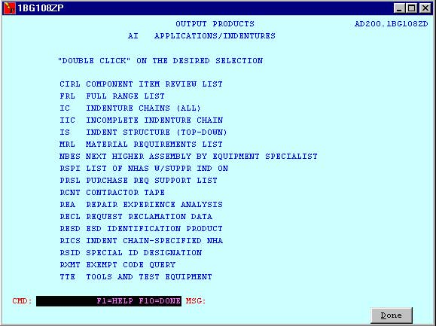
Module 4 – API Subsystem
API Subsystem
171

Slide 172
Module 4 – API Subsystem
API Subsystem
Component Item Review List (CIRL)
Displays all NHAs for specified component
Useful for locating NHAs affected by defective components or DMSMS
Displays NHA production, consumption, REPL%, and SRC
172

Slide 173
Module 4 – API Subsystem
API Subsystem
Full Range List (FRL)
Displays all components indentured to NHA
Several ways to request report:
By NHA – enter part number and CAGE, enter “Y” in all levels
Only first level components – enter “N” in all levels
By ES managing NHA – enter only ALC, pseudo-division code, and ES code
173

Slide 174
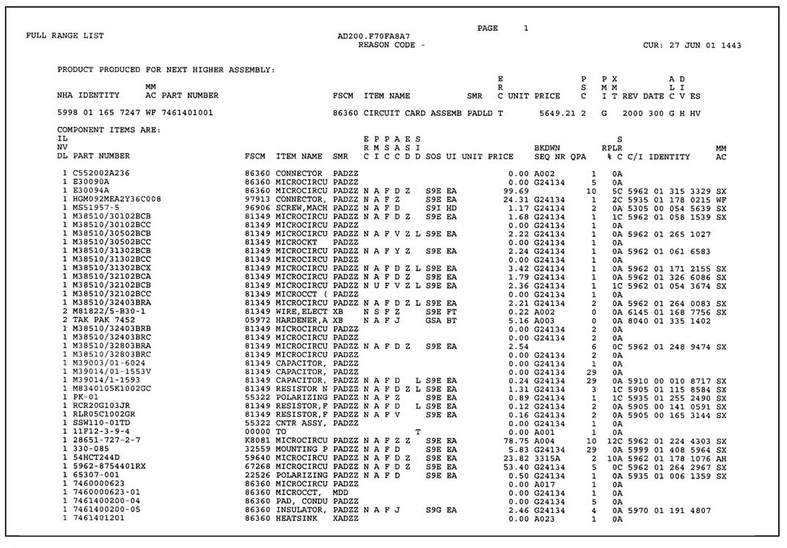
Module 4 – API System
API Subsystem
174

Slide 175
Module 4 – API Subsystem
API Subsystem
Indenture Chains (All)
Displays all indenture chains that exist for a component
Request by specifying NIIN, part number/CAGE, or TMS
If component is link in multiple chains, each indenture chain listed on separate page
175

Slide 176
Module 4 – API Subsystem
API Subsystem
Indenture Structure Top-Down
Displays NHA and its components from top to bottom
Similar to FRL but excludes tools, test equipment, bulk materials, parts kits, and TOs
May view all components or limit to components with C, P, S, and T ERRC codes
Request by entering NIIN, SPD, or part number/CAGE
176

Slide 177
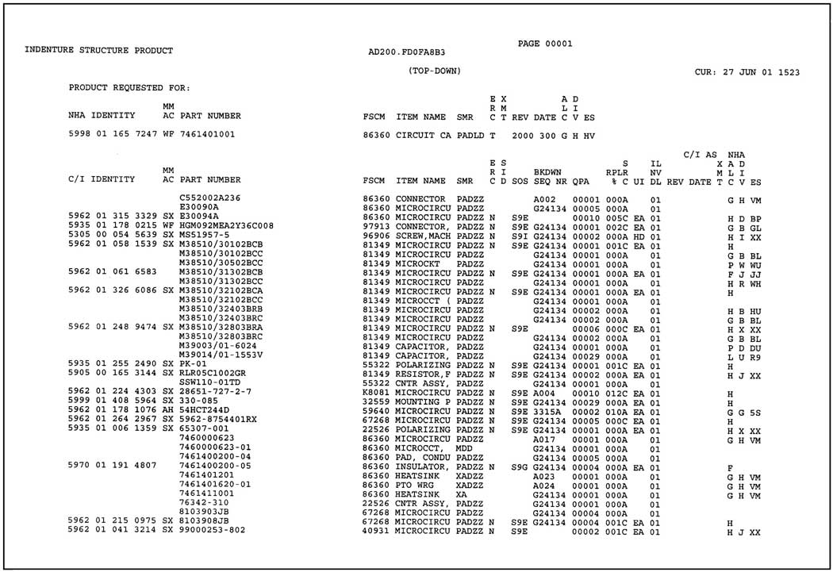
Module 4 – API System
API Subsystem
177

Slide 178
Module 4 – API Subsystem
API Subsystem
Material Requirements List (MRL)
Displays all components of NHA and repair quantity needed
Last section displays investment and expense cost information
May include all components or recoverable items only
Required to support contract maintenance
Components on list must have:
NIIN, or have a source code of AD or MD
REPL% greater than zero
Special Identification Designator other than D, E, F, G, L, R, or T
User may also request BML with this list
178

Slide 179
Module 4 – API Subsystem
API Subsystem
Bulk Materials List (BML)
Contains all components of a specified NHA with SID L (bulk material)
If “Recoverables Only” option is selected, the report will give all levels of bulk materials to point in each chain when a component is ERRC coded C, T, S, U, or a Standard Designator (unless component is SID coded W)
Each occurrence of a bulk material item within indenture structure will be included on a separate component line
Cannot be obtained without the MRL
179

Slide 180
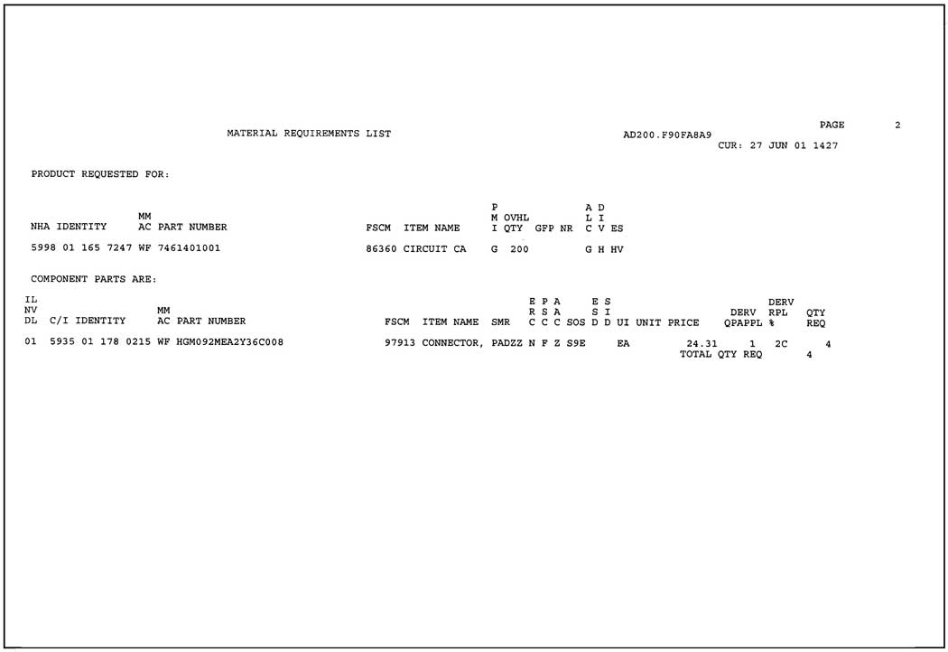
Module 4 – API System
API Subsystem
180

Slide 181
Module 4 – API Subsystem
API Subsystem
NHA by ES (NBES)
Displays every NHA in API assigned to a given ES code
Excellent report to review indentures and exempt-coded items for each ES
181

Slide 182
Module 4 – API Subsystem
API Subsystem
NHAs with Indenture Suppress Indicator On (RSPI)
NHAs appear on this report when they meet these conditions:
Indenture Suppress Indicator equals “Y”
Review Date is within the requested range or within the default range
ALC matches the ALC in the selection criteria
If specified, the DIV and ES match those selected by the requestor
Report will indicate that Indenture Suppress Indicator of those NHAs having a Review Date older than 18 months will be reset at next monthly report
182
Notes:
RSPI - ???

Slide 183
API Subsystem
Purchase Request Support List (PRSL)
Allows one MRL report for multiple NIINs (10 maximum).
Components on list must have:
NIIN, or have a source code of AD or MD
REPL% greater than zero
Special Identification Designator other than D, E, F, G, L, R, or T
Three parts:
Part 1 lists NSNs to be repaired
Part 2 lists components and quantities required to repair part 1 items
Part 3 sums cost data for part 2 component quantities
183

Slide 184
Module 4 – API Subsystem
API Subsystem
Repair Experience Analysis (REA)
Displays repaired item with production history and all components with consumption history for item
Lists same components as Indenture Structure Top-Down
Reason codes are:
A – report was requested by user
B – report was generated as result of BOM being requested through G005M
Can request report for all NHAs assigned to specific ES
184

Slide 185
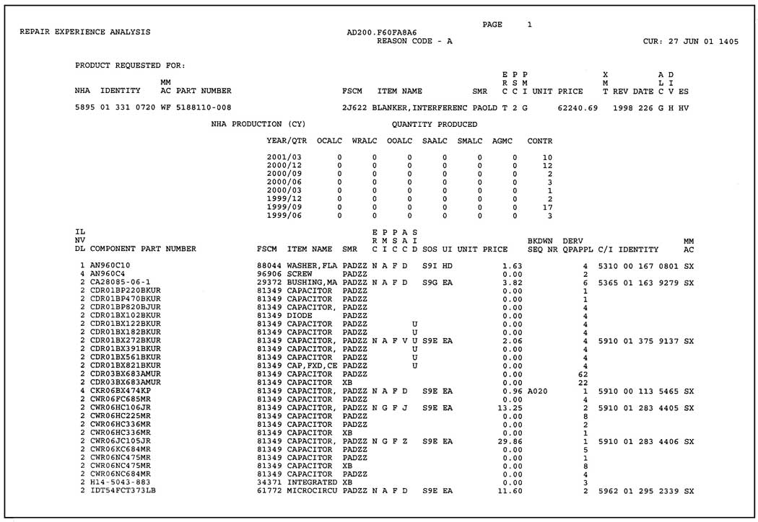
API Subsystem
Repair Experience Analysis (REA)
Displays repaired item with production history and all components with consumption history for item
Lists same components as Indenture Structure Top-Down
Reason codes are:
A – report was requested by user
B – report was generated as result of BOM being requested through G005M
Can request report for all NHAs assigned to specific ES
185

Slide 186
Module 4 – API Subsystem
API Subsystem
ESD Identification Product (RESD)
Displays all components with ESD designator
Indent Chain-Specified NHA (RICS)
Displays all indenture chains between specified NHA and component
Special ID Designator (RSID)
Displays all components of a specified NHA that are assigned a SID
Can be used to list all shop manufactured items (SID M), repair parts/kits (SID S), tech orders (SID T), or G005M parts (SID V)
186

Slide 187
Module 4 – API Subsystem
API Subsystem
Exempt Code Query (RXMT)
Displays all NHA identities for specified exempt code
Tools and Test Equipment (TTE)
Identifies and describes TTE necessary to repair NHA
May view all component levels by leaving “Recoverables Only” field blank
Entering “Y” produces all component levels to point where reparable component is noted
187

Slide 188
Module 4 – API Subsystem
API Subsystem
End of Lesson 4d
188

Slide 189
Module 4 – API Subsystem
API Subsystem
Lesson 4e
API File Maintenance (FM) Screens
189

Slide 190
Module 4 – API Subsystem
API Subsystem
Lesson Preview
Covers API file maintenance screens
190

Slide 191

Module 4 – API Subsystem
API Subsystem
API User Groups
Equipment Specialists (ES)
HQ AFMC Indenture OPR
HQ AFMC Program OPR
HQ AFMC MMM RDB Policy OPR
HQ AFMC Reclamation OPR
ALC Indenture Monitor
ALC Program Monitor
Systems Program Manager (SPM)
Production Management Specialist (PMS)
Reclamation Program Control Officer (RPCO)
Only ES can file maintain indentures
ES must be owner of higher assembly/end item
191

Slide 192
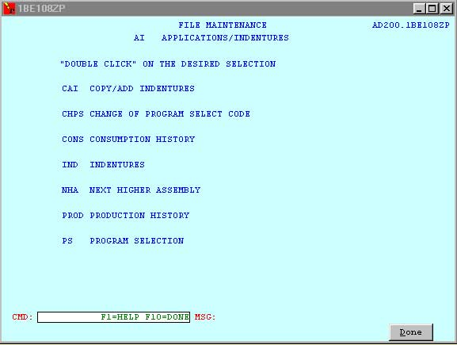
Module 4 – API Subsystem
API Subsystem
File Maintenance
192

Slide 193
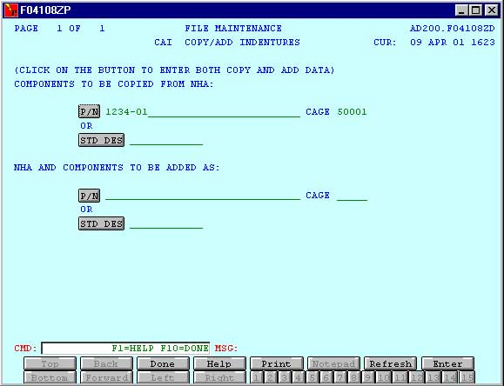
Module 4 – API Subsystem
API Subsystem
Copy/Add Indenture (CAI)
193

Slide 194
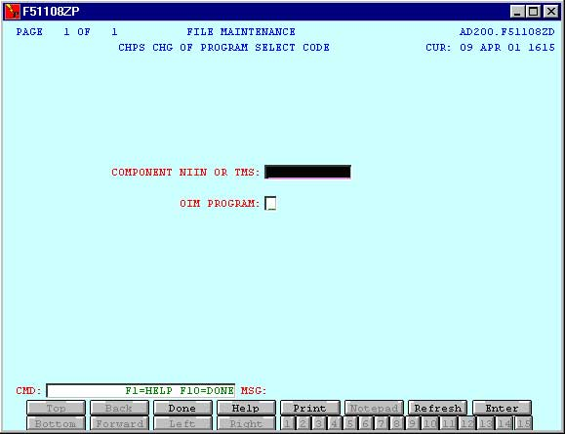
Module 4 – API Subsystem
API Subsystem
Change of Program Select Code (CHPS)
194

Slide 195
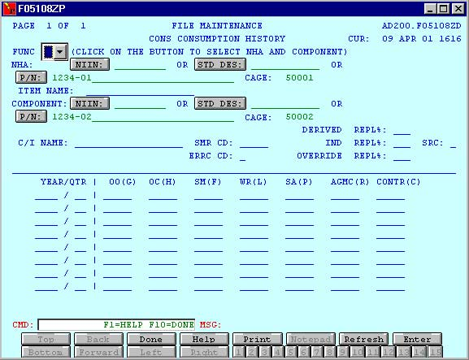
Module 4 – API Subsystem
API Subsystem
Consumption History (CONS)
195

Slide 196
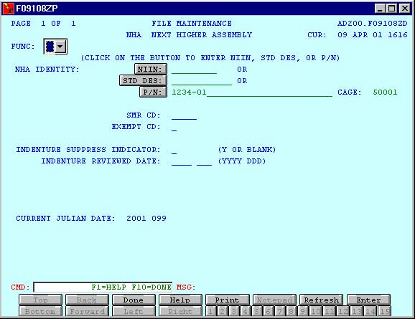
Module 4 – API Subsystem
API Subsystem
Next Higher Assembly (NHA)
196

Slide 197
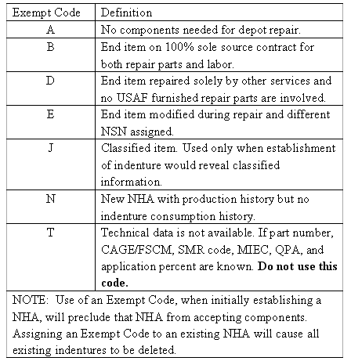
Module 4 – API Subsystem
API Subsystem
NHA Exempt Codes
197

Slide 198
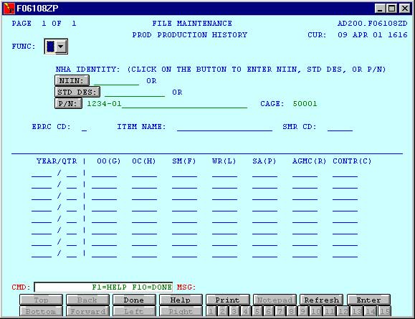
Module 4 – API Subsystem
API Subsystem
Production History (PROD)
198

Slide 199

Module 4 – API Subsystem
API Subsystem
Program Selection (PS)
199

Slide 200
Module 4 – API Subsystem
API Subsystem
End of Lesson 4e
200

Slide 201
Module 4 – API Subsystem
API Subsystem
Lesson 4f
Indenture (IND) Screen in File Maintenance
201

Slide 202
Module 4 – API Subsystem
API Subsystem
Lesson Preview
Reviews procedures for entering and modifying indenture records in API
202

Slide 203

Module 4 – API Subsystem
API Subsystem
203

Slide 204

Module 4 – API Subsystem
API Subsystem
New Indenture Walkthrough
204

Slide 205

Module 4 – API Subsystem
API Subsystem
New Indenture Walkthrough
Step 1) Access Indentures screen
Step 2) Select Blank function to clear existing data from screen
205

Slide 206





Module 4 – API Subsystem
API Subsystem
Function Codes
206

Slide 207


Module 4 – API Subsystem
API Subsystem
NHA Information
Step 3) Enter the Cartridge Assembly as the NHA
New indentures must be added by part number/CAGE not NIIN
207

Slide 208

Module 4 – API Subsystem
API Subsystem
NHA Data
Step 4) Enter Identification Plate as component
Step 5) Select (A) in the Function field to add new indenture
Step 6) If necessary, confirm entry of NHA and component
Step 7) Enter the SMR Code for the NHA
208

Slide 209
Module 4 – API Subsystem
API Subsystem
NHA Data
SMR code is mandatory entry when establishing indenture
Review date indicates when NHA in relationship was last reviewed (entered on NHA screen)
Review includes ensuring all component parts are properly indentured and all indenture data is valid and current
ERRC code can only be changed through a cataloging action
Name part established through cataloging
209

Slide 210

Module 4 – API Subsystem
API Subsystem
Component Data
Step 8) Enter the SMR code
Step 9) Enter the QPA
Step 10) Enter the Subsystem and Item Essentiality Codes
210

Slide 211
Module 4 – API Subsystem
API Subsystem
Essentiality Codes
ES has responsibility to file maintain three position MIEC for each application record in API
MIEC has three positions/components:
1) System Essentiality Code (SEC)
2) Subsystem or Equipment Essentiality Code (SSEC)
3) Item Essentiality Code (IEC)
211

Slide 212

Module 4 – API Subsystem
API Subsystem
212

Slide 213

Module 4 – API Subsystem
API Subsystem
213

Slide 214

Module 4 – API Subsystem
API Subsystem
214

Slide 215

Module 4 – API Subsystem
API Subsystem
Special Identification Code (SID)
One objective of API is to provide repair information for special resources
Everything required for depot repair of NHA must be indentured
SID provides a method to identify resources as components in the indenture that are non-standard parts
215

Slide 216

Module 4 – API Subsystem
API Subsystem
216

Slide 217

Module 4 – API Subsystem
API Subsystem
Electrostatic/Electromagnetic Sensitive Devices (ESD)
Single field that identifies component items that may be damaged by electrostatic/electromagnetic energy
Sensitive items are coded “Y”
ESD information is overlaid to API
217

Slide 218

Module 4 – API Subsystem
API Subsystem
Program Select Override Data
Program Select Override data are displayed for information and cannot be entered on the IND screen
218

Slide 219

Module 4 – API Subsystem
API Subsystem
Program Select Data
Program Select data can be entered when an indenture is established (Program Select Code and Program Begin Date are required)
Program Select data establishes Program Select Record which provides link between indenture and program
Program Select data may be added when fields are open (data can also be entered on Program Select (PS) screen)
219

Slide 220

Module 4 – API Subsystem
API Subsystem
Enter Component Data
Step 11) Press enter to add component data and then press Done
220

Slide 221
Module 4 – API Subsystem
API Subsystem
End of Lesson 4f
221

Slide 222

Course Evaluation
222

Slide 223





448th Supply Chain Management Wing
The Supply Chain Delivers …
Parts on the Shelf and Contracts in Place

